Slide 1
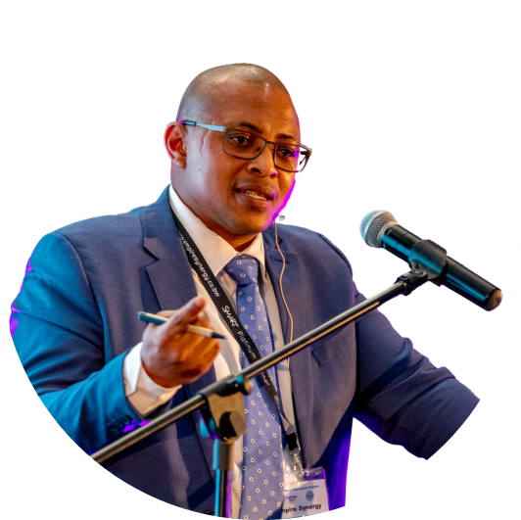
Our Journey in Education Digital Transformation
By: Peter M. Mooketsane

Slide 2
VISION
To be a key player in Africa for Education Technology Solutions: Meaningfully Transforming the lives of EDUCATORS and LEARNERS in order to produce 21st Century Globally Competitive Human Resources
MISSION
Using both traditional and new teaching and learning methods we aim to: 1. Achieve Learner Success by improving learner engagement, learner attendance, learner comprehension, understanding, and ultimately performance.
2. Achieve Educator Success by capacitating educators with the necessary ICT skills to author and deliver digitally media rich, interactive and engaging curriculum approved lesson content. Capacitate the teacher to deliver personalised learning and continuous learner assessment.
Driven by passion for innovation.

Slide 3
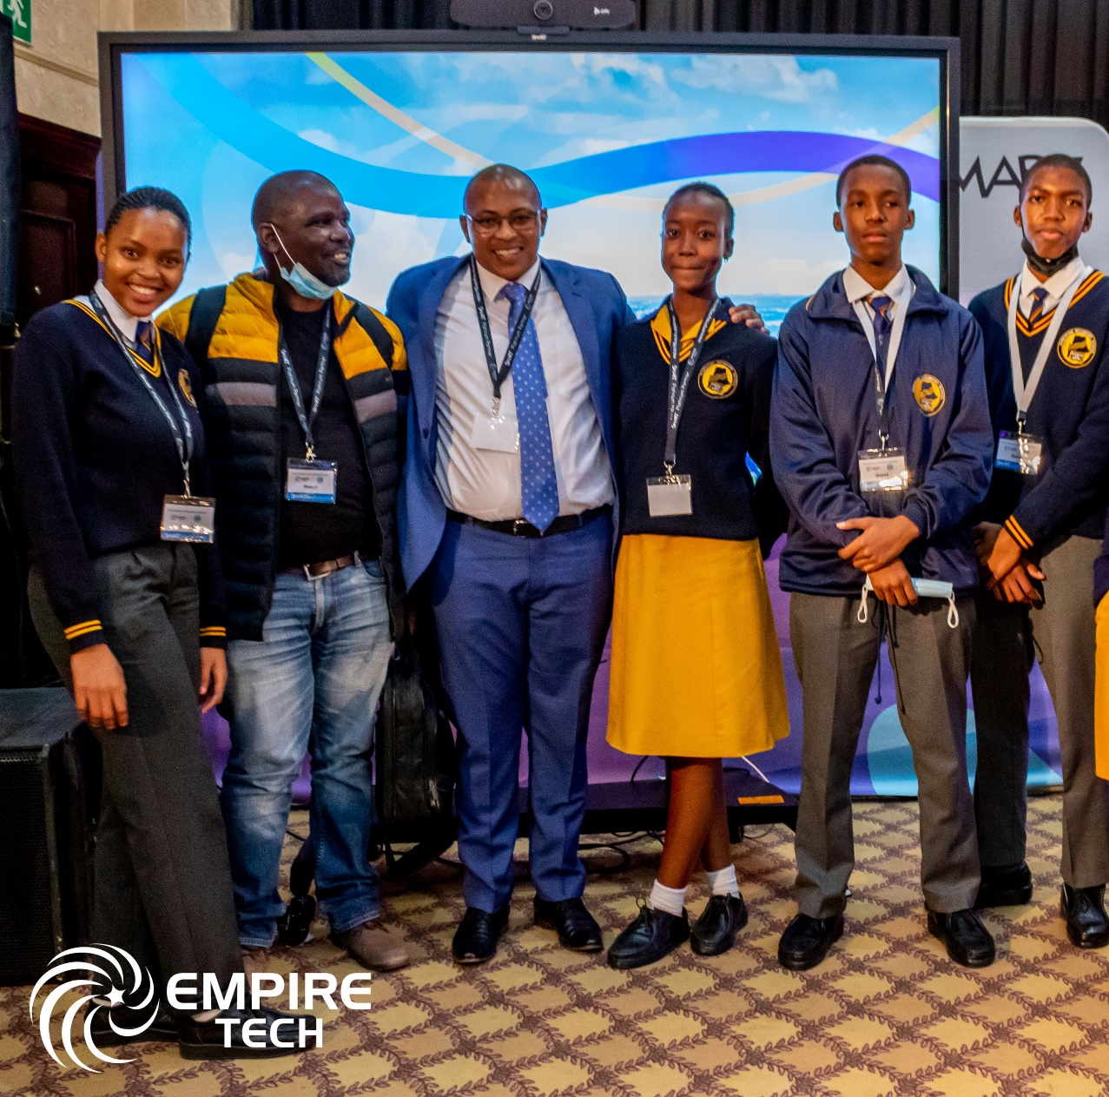
OUR
VALUES
TEAMWORK
TRANSPARENCY
EXCELLENCE
PASSION
ACCOUNTABILITY

Slide 4
COMPANY OVERVIEW
INCORPORATED ON THE 05TH JANUARY 2005 IN THE REPUBLIC OF BOTSWANA
19+ YEARS IN BUSINESS AND 16+ YEARS SPECIALISING IN EDTECH SOLUTIONS
LICENSED AS AN ICT DISTRIBUTOR AND ICT EQUIPMENT MAINTENANCE WORKSHOP
LICENSED AS A MANUFACTURER FOR THE ASSEMBLY OF COMPUTING DEVICES
ACCREDITED AS A TRAINING INSTITUTION UNDER THE BOTSWANA QUALIFICATIONS AUTHORITY (BQA)
Driven by passion for innovation.

Slide 5
INDUSTRY COMPLIANCE, REGISTRATION, ACCREDITATION AND AFFILIATIONS
Industrial Affairs
Economic Diversification Drive (EDD) Unit

Slide 6
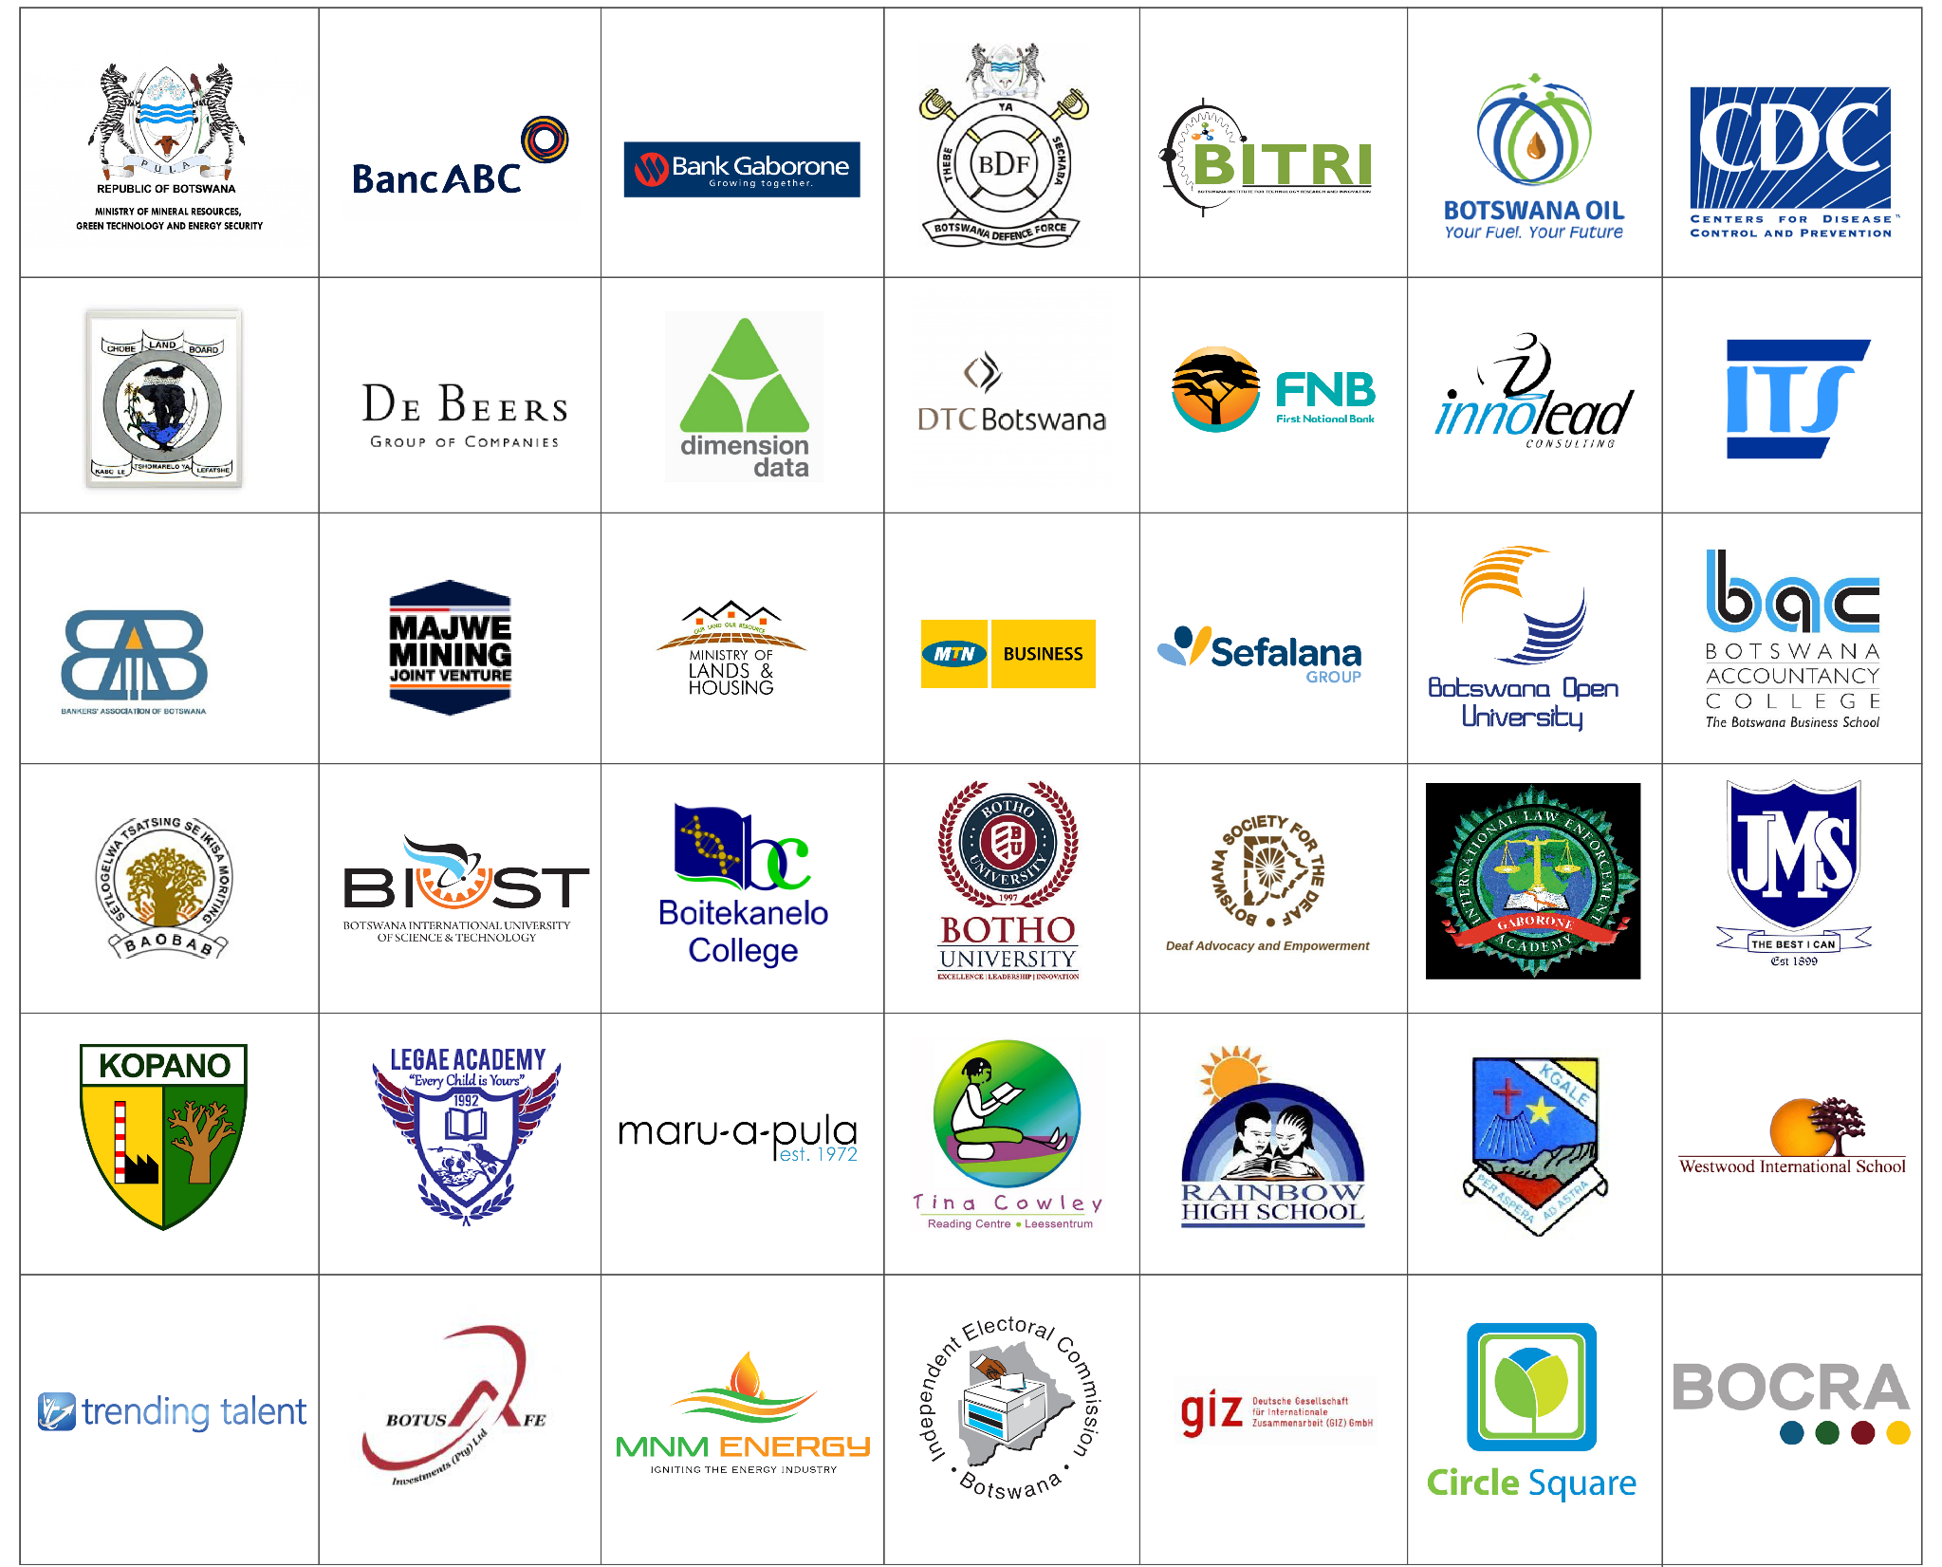
Our Clients
z

Slide 7
Assembly Plant and Repair Centre Overview
Capacity of up to 20 People per shift
11 Electro Static Dissipant (ESD) Workbenches
Fully Electro Static Dissipant (ESD) Environment
500 Device Daily Production Capacity
Semi-Knock Down (SKD) High-Level Assembly Line
After Service Repair and Maintenance Center

Slide 8
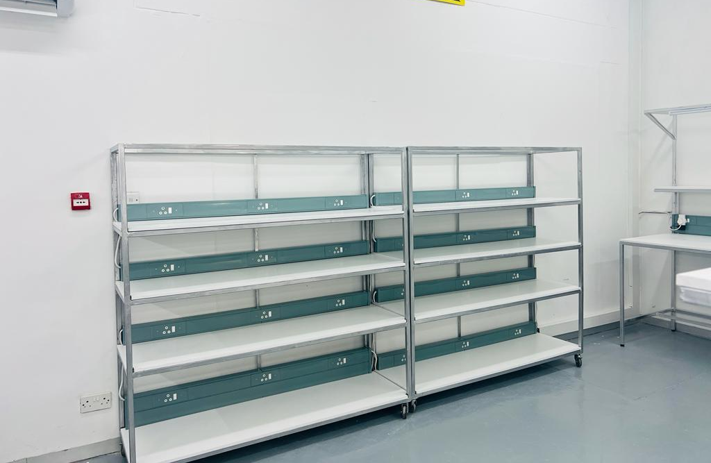
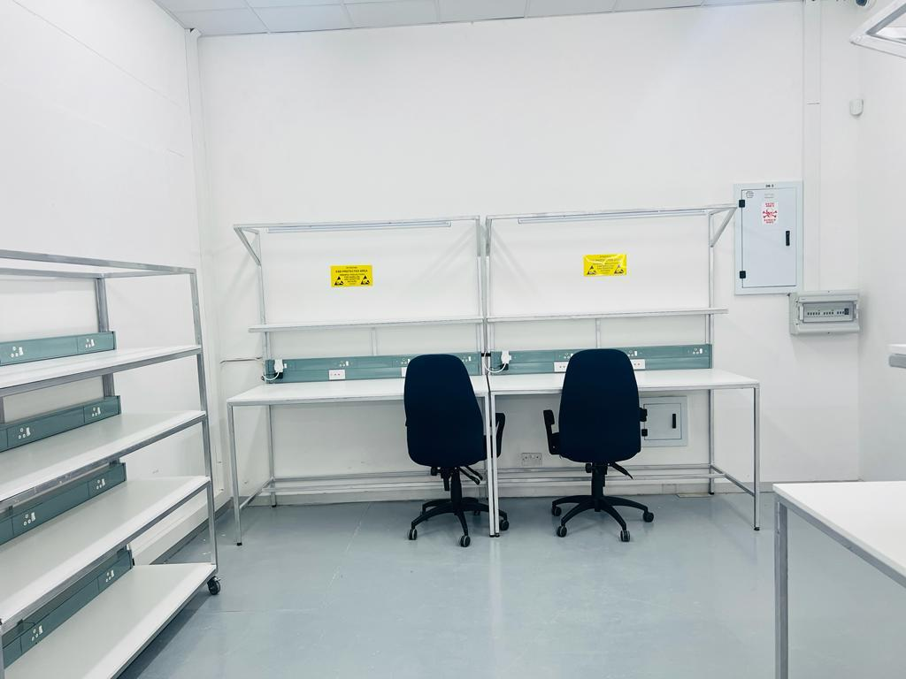
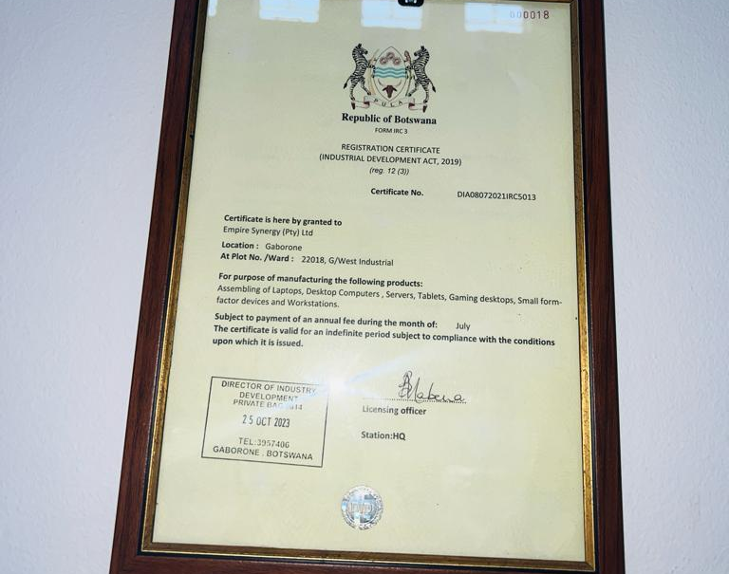
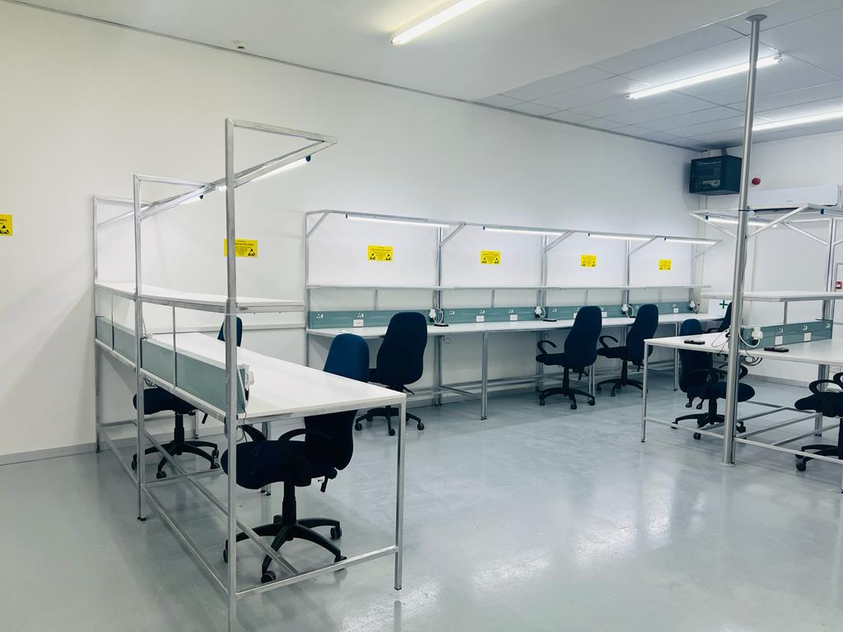

Slide 9
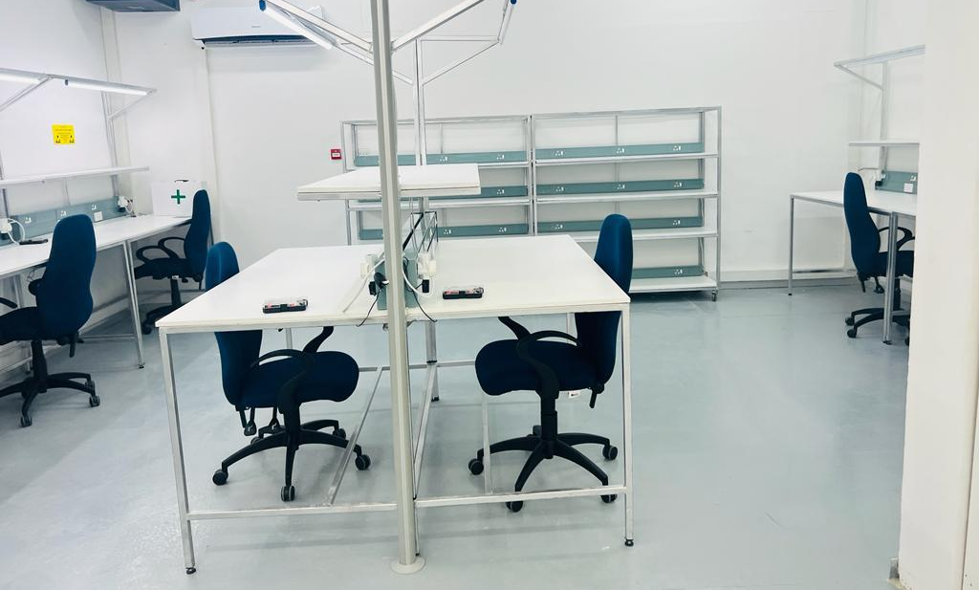
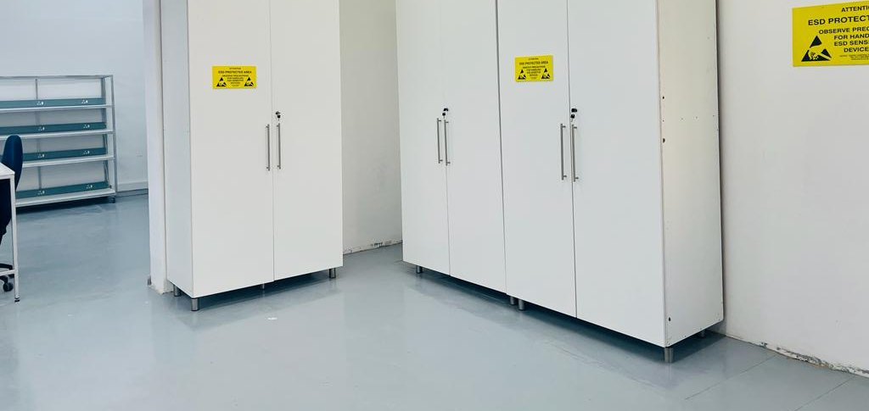
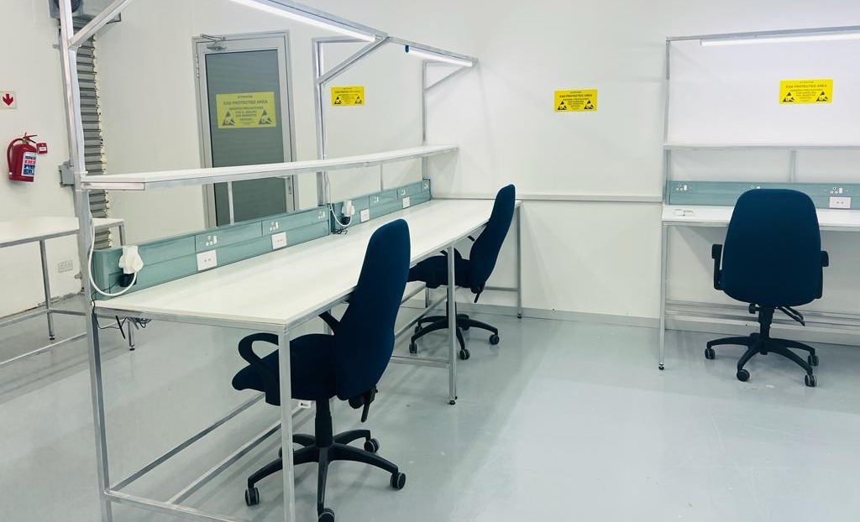
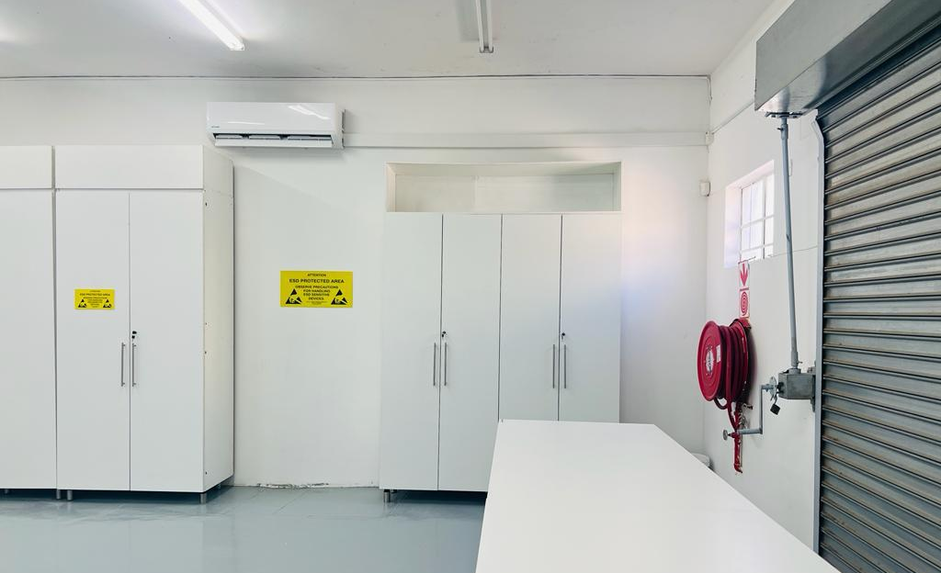
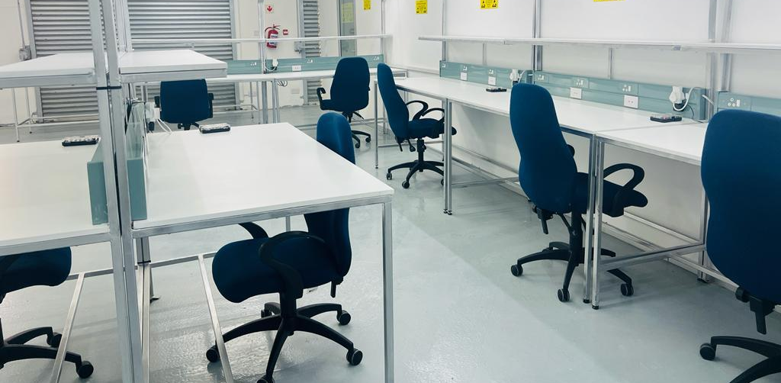

Slide 10
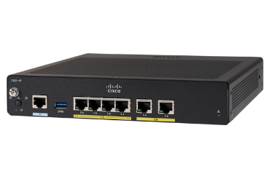
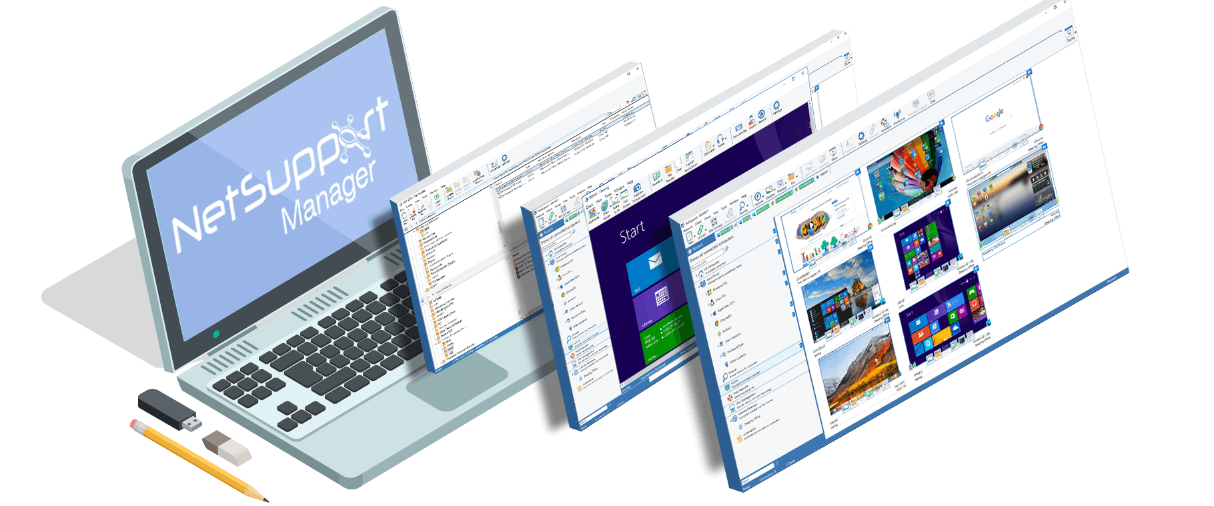
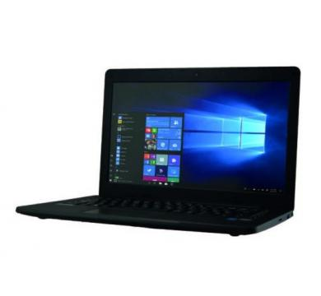
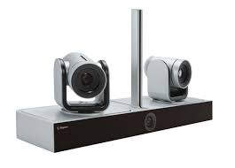
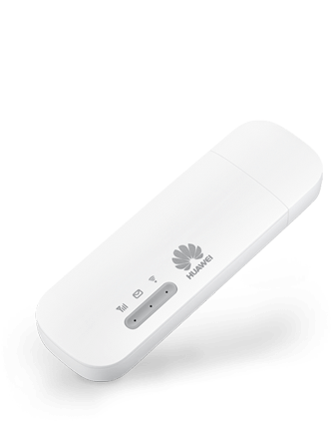
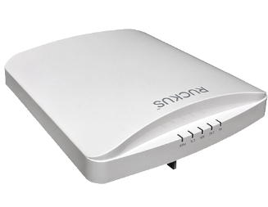
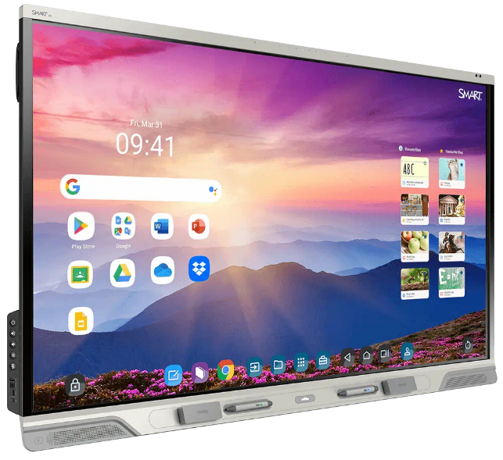
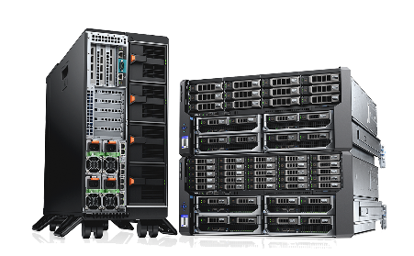
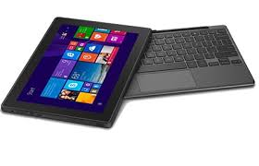
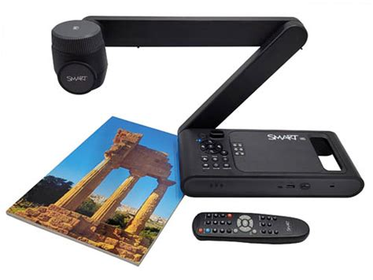
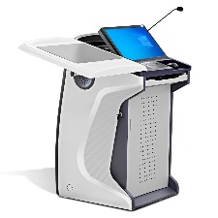
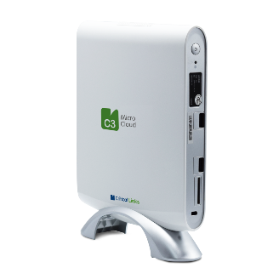
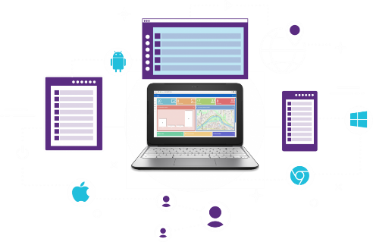
OUR EDUCATION DIGITAL TRANSFORMATION ECO-SYSTEM
SERVICES
CONNECTIVITY
SERVICES
SOFTWARE
Custom Device Design and branding
ICT Consulting
Routers
Operating Systems
Classroom Management
Local Area Network
Classroom Audio (Mics and Speakers)
Installations
ICT Training
Teacher Devices
Web-Camera
Access Points
Teacher/Student Collaboration
4G/5G
Technical Support
Web-Conferencing
Technology Integration
Servers
Student Devices
Technology Inventory Audit
Front of Classroom Technology
Vendor Specific End User and Technical Support Training
Learner Management
Websites/Intranet
E-Mail
HARDWARE
Visualisers
Multimedia Podiums
Content Creation Training
Cloud Services
Productivity
Cloud Services
Maintenance Contracts and Service Level Agreements (SLAs)
Content Server
Technology Remote Management
COMMUNICATIONS/CLOUD

Slide 11
Our 16 Y.O. Company Milestones with Educational Devices Vendors
2005
Our Company Was Incorporated
2008
We began our journey in Educational Technology by Partnering with SMART Technologies (SMART Boards)
2012
HP Silver Partner Status
2012
SMART MOU Signed with Ministry of Education and Skills Development (MESD) for Educational Technology POC
2020
Signed Sole Agreement with JP.IK for the supply of their products in Botswana (Distributorship)
2021
Registered with Department of Industrial Affairs for Manufacturing/ Assembly Plant
Cisco Authorised Partners
Relationship with JP Sa Couto began
Became Dell Partners
2016
2023
Finalisation of Industry Grade Assembly Plant in Gaborone, Botswana
We continue to grow and develop further into African Industrialists!

Slide 12
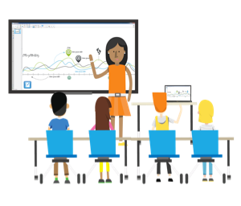
SHIFTING PEDAGOGY CONCEPT
16 years ago, our company embarked on a journey to transform and modernise the education landscape of Botswana by SHIFTING PEDAGOGY through the introduction of Technology into the CLASSROOM
Primarily
teacher-centered learning
Primarily
student-centered learning
Transitional

Slide 13
Pedagogy
Our Education Technology Solutions adoption process is Teacher Driven but Student-Centric
= derived from Greek word: to lead the child
= teaching skills required to impart knowledge of their subject area

Slide 14
TEACHING AND LEARNING BEST PRACTICES – BEST APPROACH FOR INTEGRATION OF ICT INTO EDUCATION
Efficacy and Implementation
How do we measure learner success, outcomes and impact?
By implementing a "4 E" teacher implementation programme
Engage - Enhance - Extend - Empower
Sustainable, Scalable and Capacity Building
FUTURE SOURCE

Slide 15
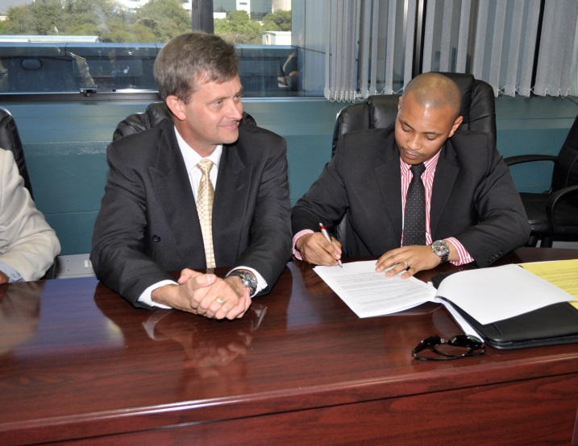
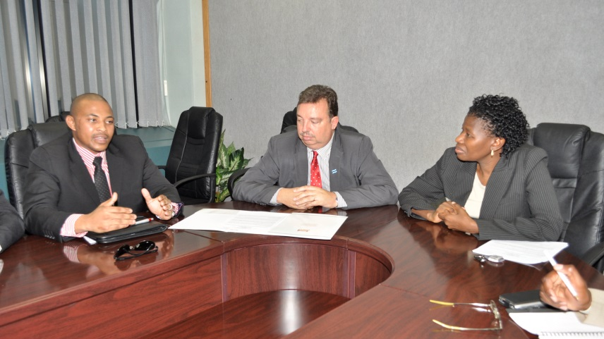
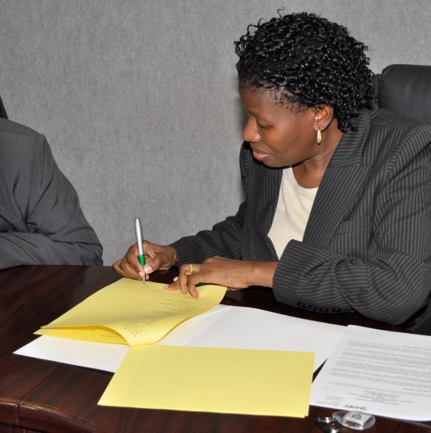
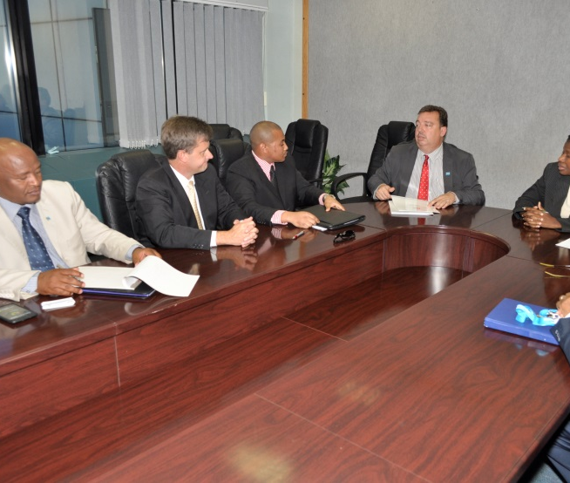
TUESDAY 5TH JUNE 2012
MEMORANDUM OF UNDERSTANDING (MOU) WAS SIGNED BETWEEN THE MINISTRY OF EDUCATION AND SKILLS DEVELOPMENT (MOESD) AND SMART PARTNERS

Slide 16
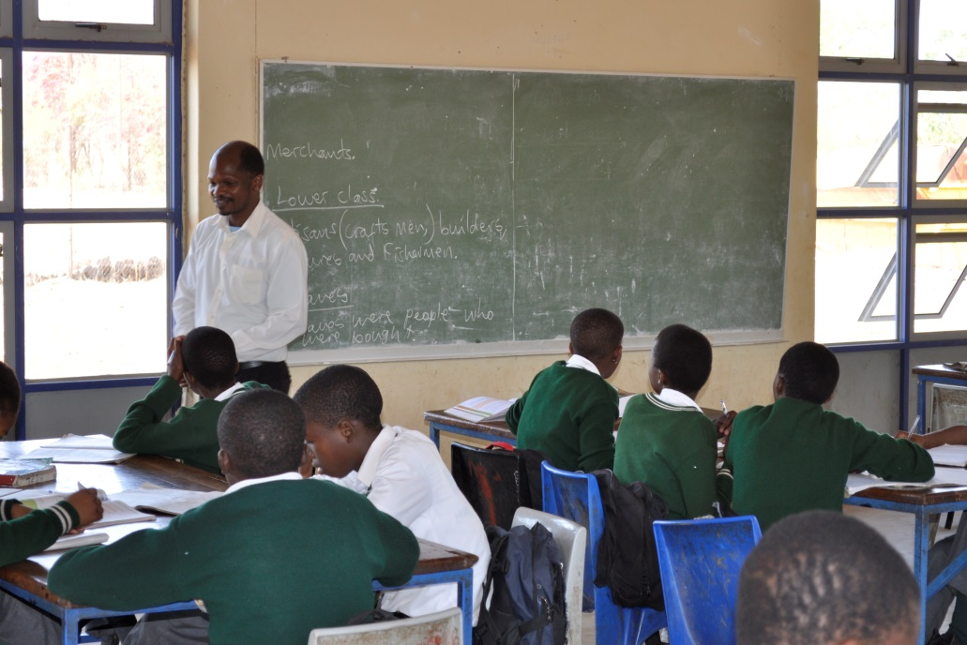
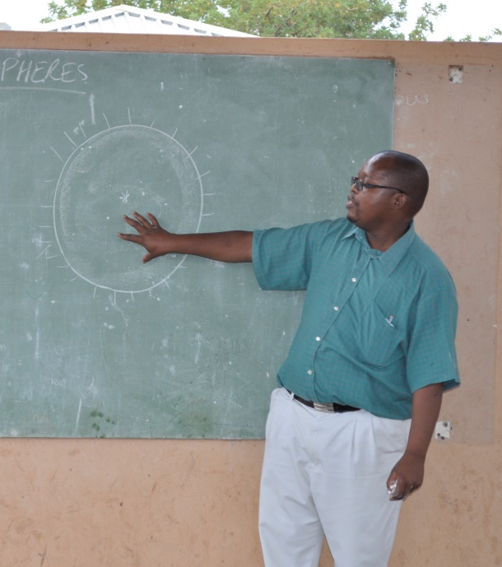
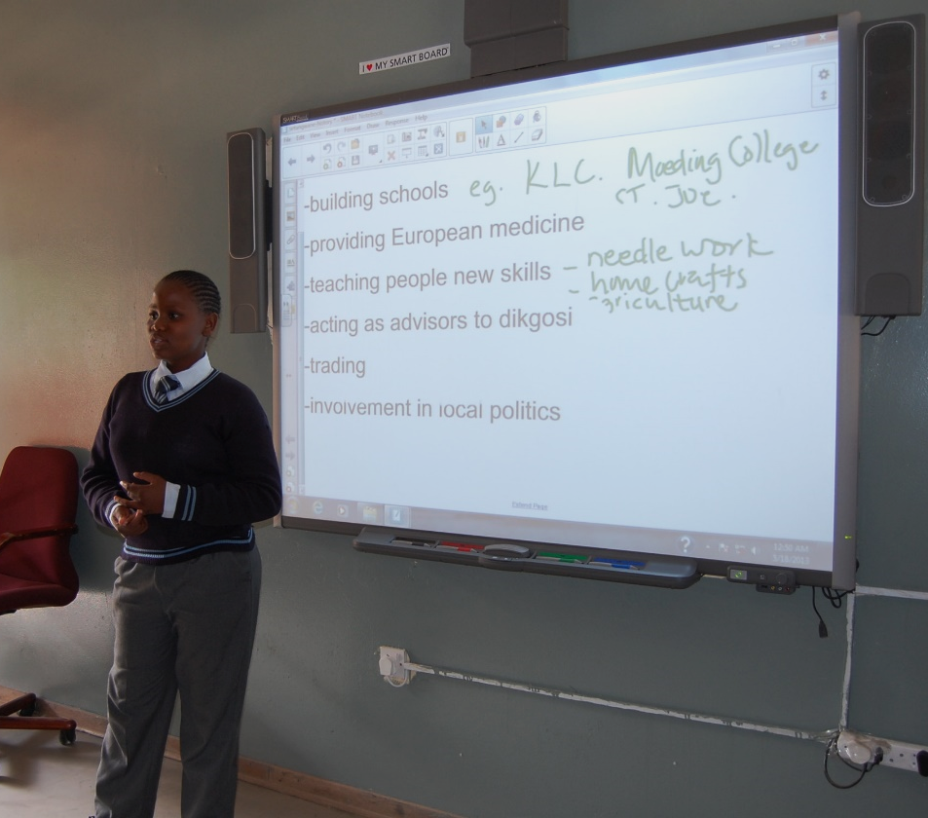
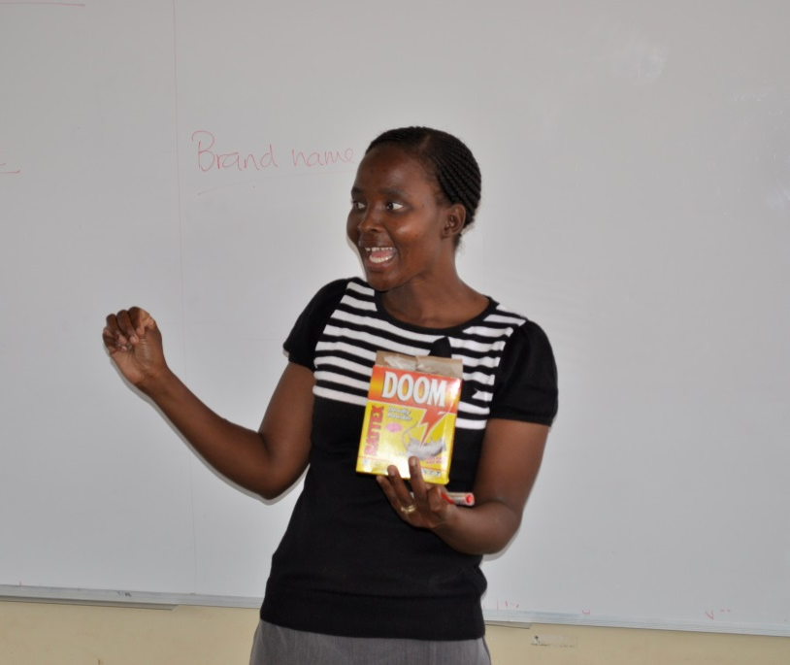
BEFORE TRANSFORMATION
AFTER TRANSFORMATION

Slide 17
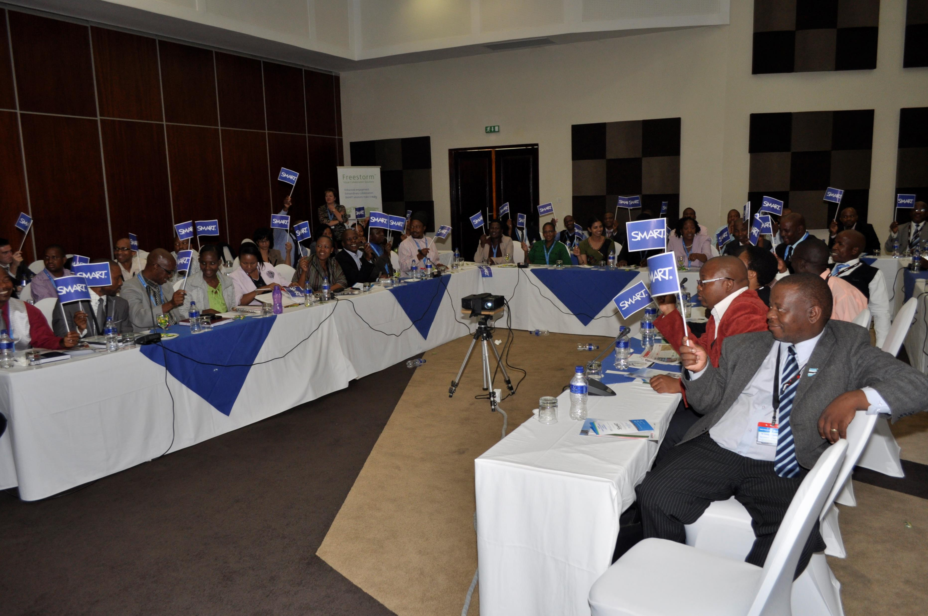
Our Proof of Concept a Success!
BWP4,000,000.00 (ZAR5,300,000.00) worth of Products and Services Donated
Four Secondary Schools and One Teacher Training College Benefication
17 Classrooms Transformed
Forty-Two (42) Teachers Trained (>300 hours of training delivered)
Botswana Educational Research Association (BERA) evaluation of the project deemed it a success and the technology fit for roll out throughout the country!

Slide 18
Successfully Completed CSI and POC Projects
2011 – Making Westwood International School the first SMART Showcase School and equipping them with front of classroom technology in 90% of their classrooms, including training all of their teachers on technology usage and content creation
2012-2014 – Proof of Concept for SMART Board solutions for 17 classrooms in four (4) schools and one (1) teacher training college with Ministry of Education and Skills Development (June 2012 - 2014)
2012-2015 – Assisting the British Council with their “Connecting Classrooms” Initiative by installing and training on technology at three (3) remote schools in Botswana
2015 – Francistown and Ramotswa Centres for Deaf Education, Provision of Interactive Projectors, Desktop Computers, Sign Language Books and Collaboration Software in partnership with Diamond Trading Company Botswana (DTCB)
2018 – Provision of Mobile ICT Labs with 20x 2-in-1 Devices, 1x Intel Education Content Access Point and 1x Charge and Sync Trolley for 8 remote public Primary Schools in conjunction with Japanese Embassy through the Botswana Ministry of Education and Skills Development
2019 – Nare Sereto Junior Secondary School Donation of SMART Board Interactive Whiteboard and Training to 10 Teachers
2019 – Botswana Telecommunications Corporation (BTCL) Proof of Concept with Gaborone Senior Secondary School where we complemented the campus wide High Speed Internet they were showcasing with Empire Tech’s education classroom technology
z

Slide 19
2011
Provision of Technology to the Botswana Educational Television (BETV) for daily lesson delivery on the BETV Channel
2016
Providing the Botswana Accountancy College (one of the top five universities in Botswana) with SMART Interactive Displays and Projectors throughout their campus lecture rooms and labs
SIGNIFICANT PROJECT MILESTONES OVER THE YEARS
2017
Provision of Computer Lab ICT Solutions for Classrooms in Central Botswana Schools, including Servers, 2-In-1 Tablets, Charge and Sync Trolleys, Networking and Wi-Fi Connectivity
Project Management of the Supply, installation, commissioning and training of ZAR 10 Million worth of Data Management and Communication Equipment for the Botswana Defence Force Defence Command and Staff College
2017
2021
Provision of Interactive Displays, Tablets, Accessories and training of 300 teachers. This service was delivered to a total of fifteen (15) schools in partnership with Botswana Telecommunications Corporation (BTC)
2022
Provided eight (8) public primary schools with mobile computer labs as contracted by the Universal Access and Service Fund (UASF)

Slide 20
LANDMARK PROJECT WITH BOCRA/UASF

Slide 21
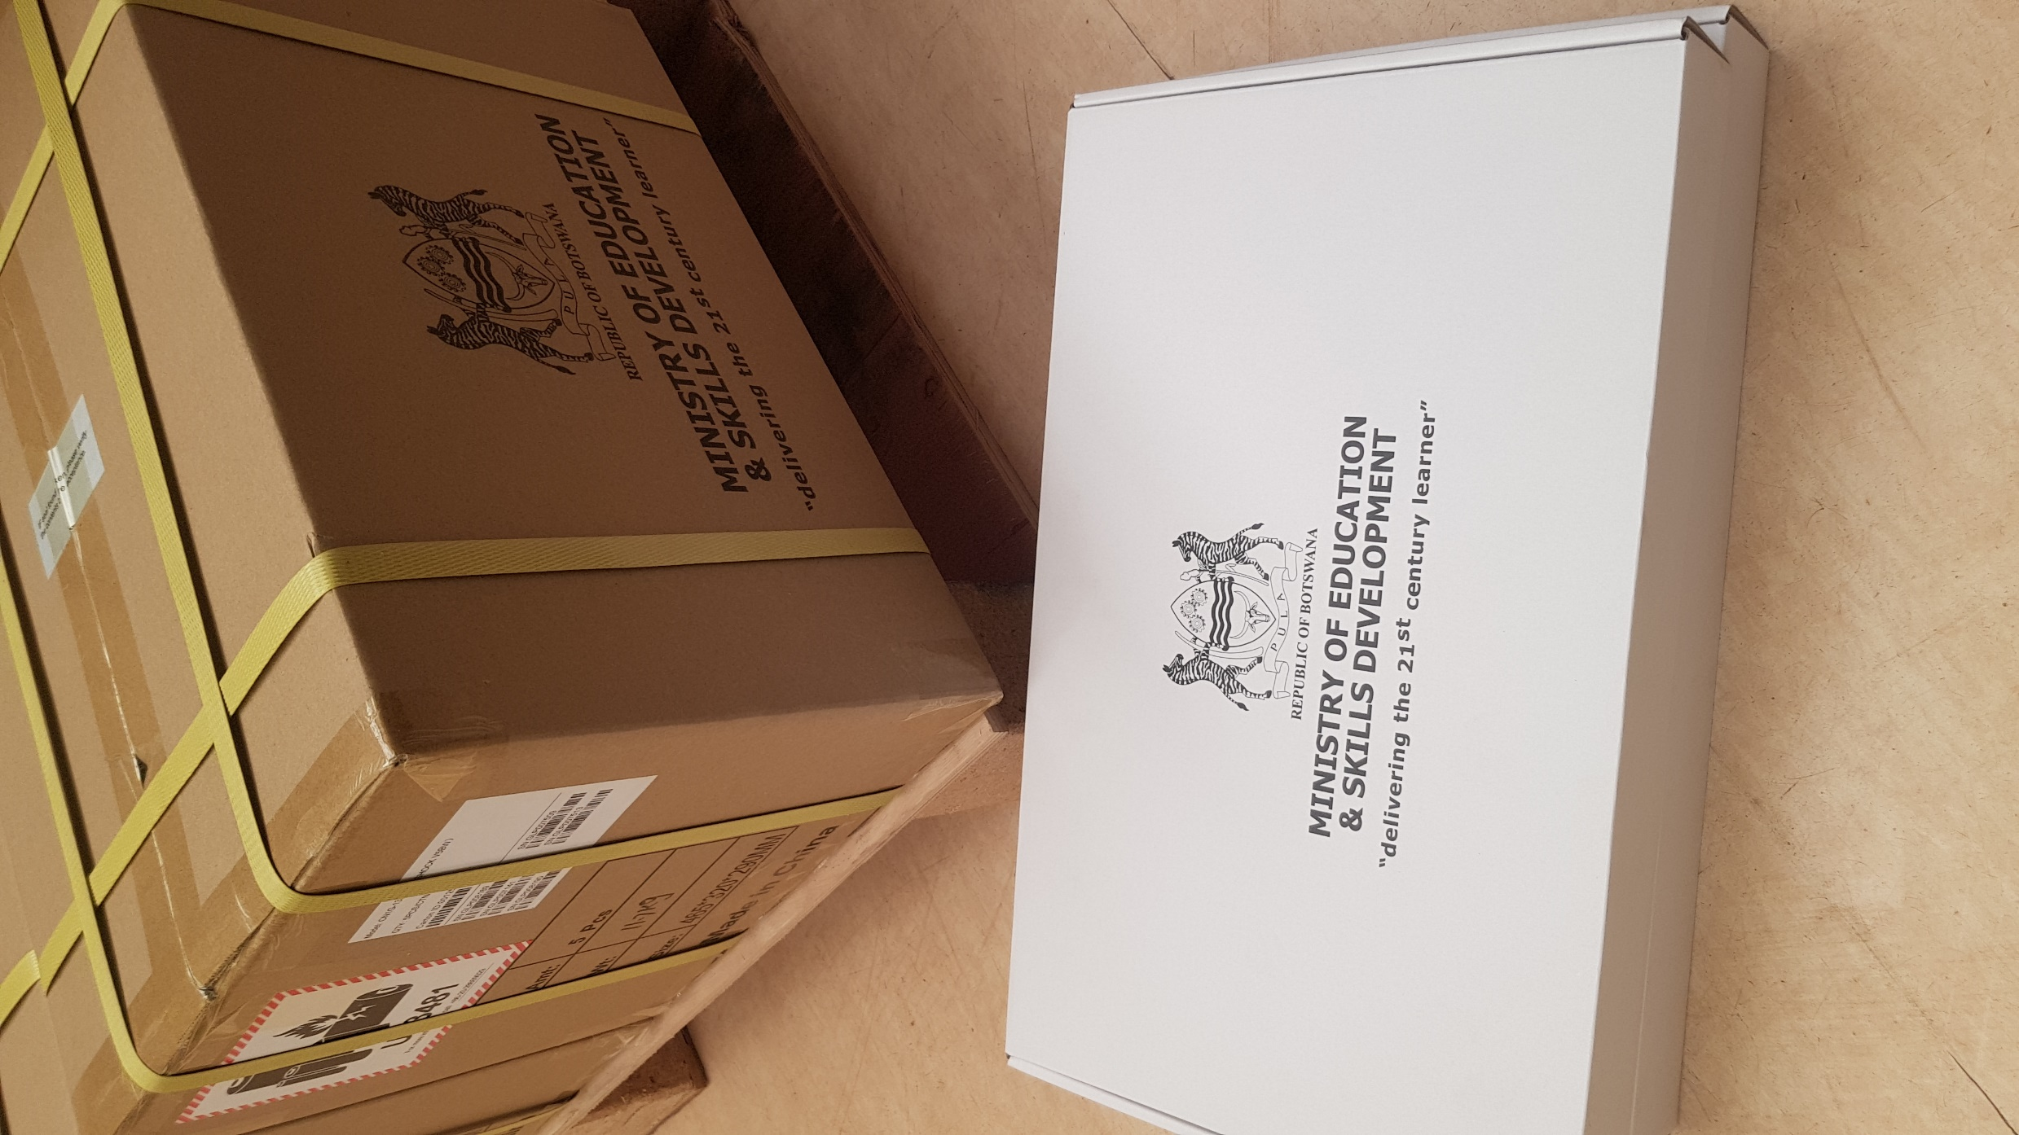
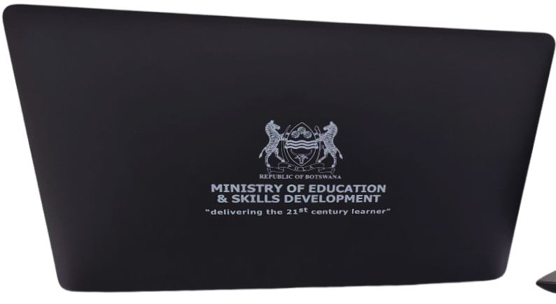
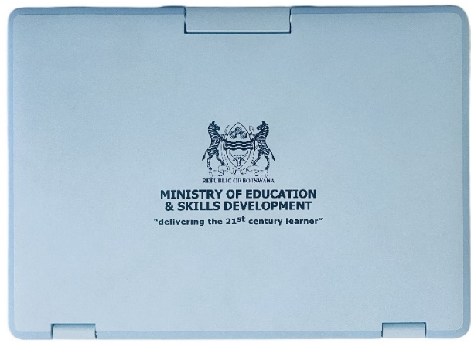
BOCRA UASF Project – Biggest Botswana Device Roll Out Ever
Supply, delivery, and 3-year warranty and out-of-warranty support of 26,607 Student laptop Devices with 3 year device tracking capability
Supply, delivery, and 3-year warranty and out-of-warranty support of 2,260 Teacher laptops.
Supply, delivery, and 3-year warranty and out-of-warranty support of 51 trainer or Trainers (ToT) laptops.
16 out of 34 Government Senior Secondary Schools in Botswana, under the Ministry of Education and Skills Development and Universal Access and Service Fund (UASF)
Project Duration: Effective from November 2021 and completed in December 2022. Device Warranty Valid until December 2025.

Slide 22
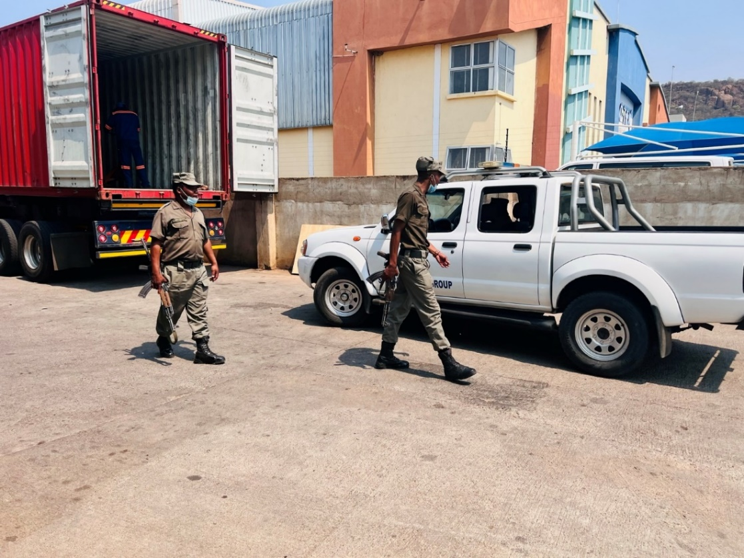
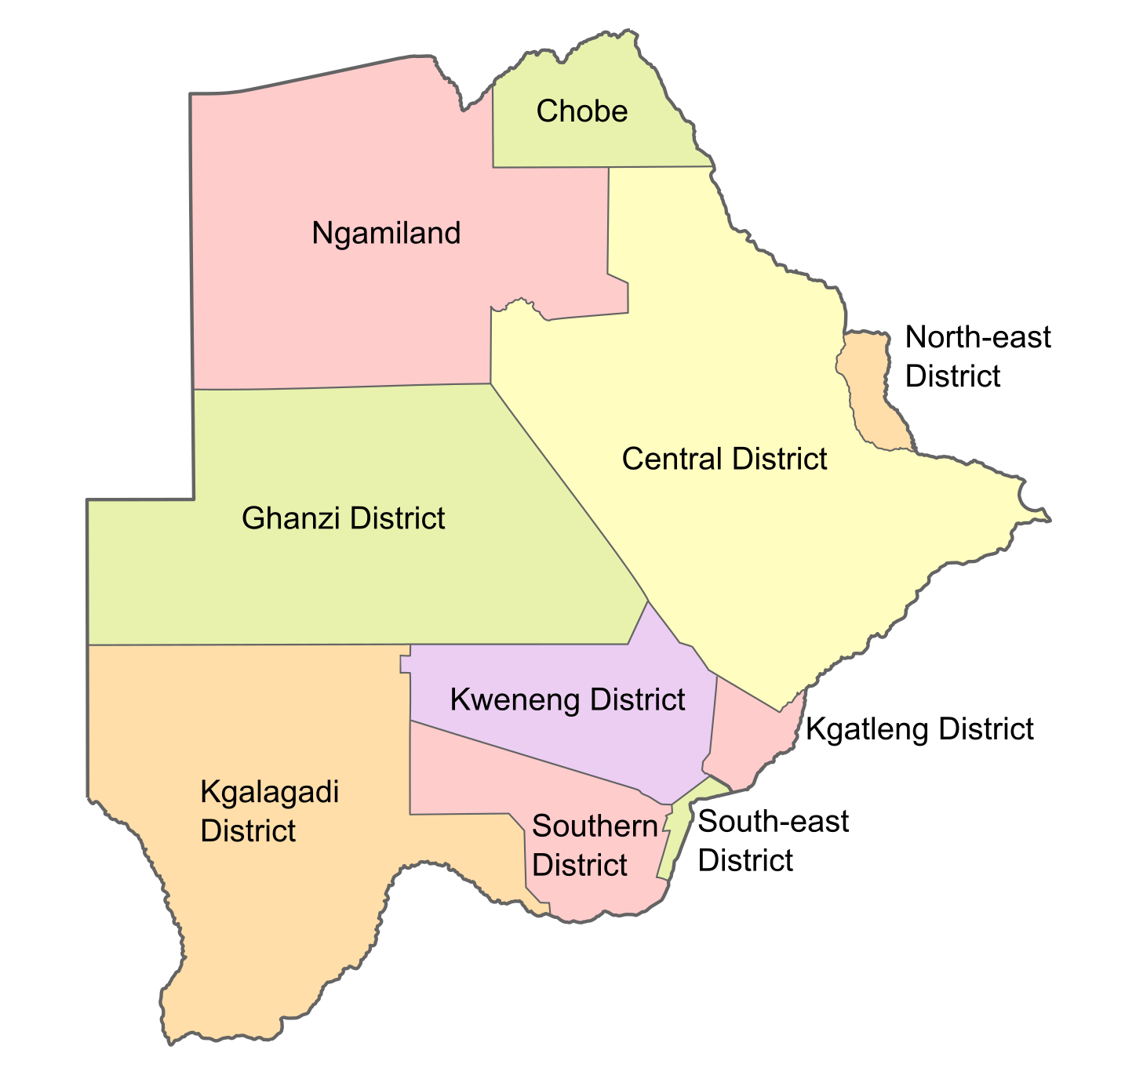
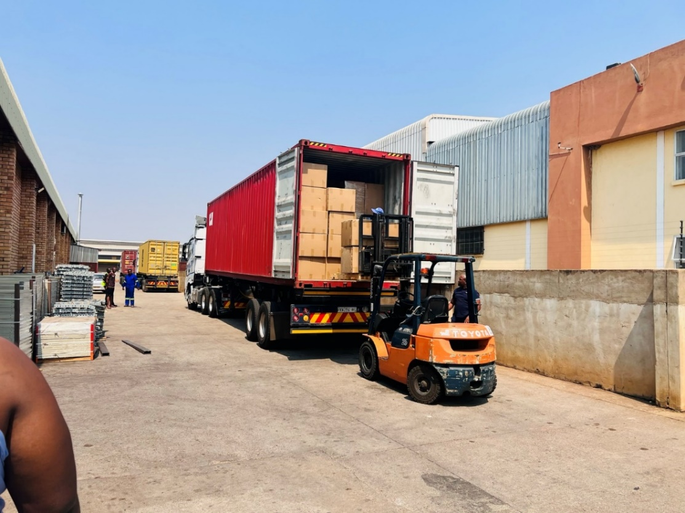
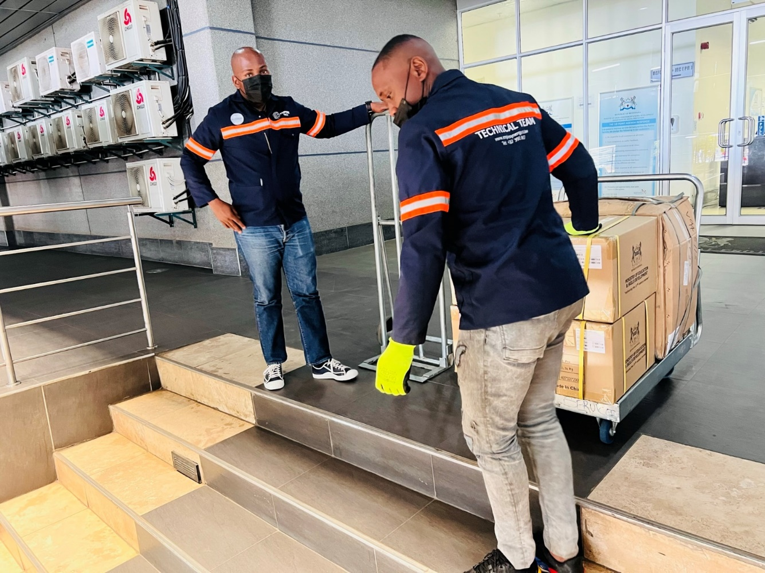
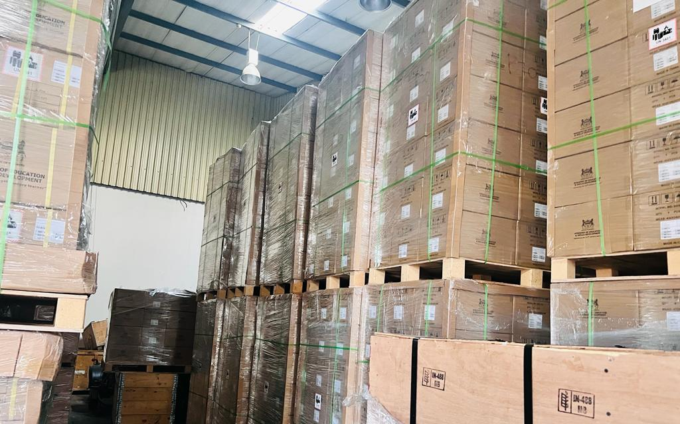
Botswana Minister of Education and Skills Development (MESD) Hon Dr. Douglas Letsholathebe

Slide 23
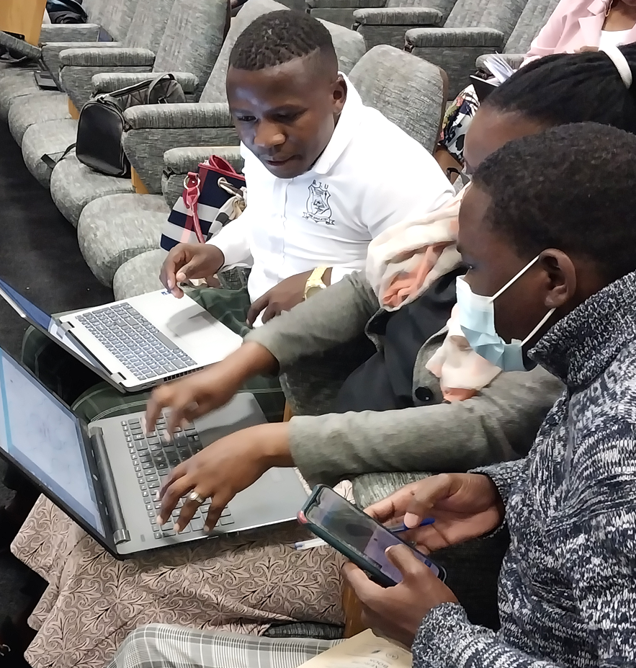
Common Challenges with Digital Transformation in Education
These are just a few of the common challenges that educational institutions face when undertaking digital transformation initiatives. Addressing these issues through thoughtful planning, equitable resource allocation, and robust teacher training programs can help ensure the successful and inclusive implementation of digital technologies in the education sector.
Inequality and Accessibility
Resistance to Change
Lack of Adequate Training and Support:
Digital transformation in education can exacerbate existing inequalities if not implemented carefully. Students from lower-income backgrounds may lack access to necessary devices, internet connectivity, or digital literacy skills, putting them at a disadvantage compared to their more privileged peers.
Implementing significant technological changes in educational systems can be challenging due to resistance from teachers, administrators, and even students who may be uncomfortable with unfamiliar digital tools and workflows. Successful digital transformation requires overcoming this institutional inertia and ensuring buy-in from all stakeholders.
Effective integration of digital technologies in the classroom requires comprehensive training and ongoing support for teachers. Many educational institutions struggle to provide sufficient resources and professional development opportunities to help teachers effectively utilize new digital tools and incorporate them into their teaching practices.

Slide 24
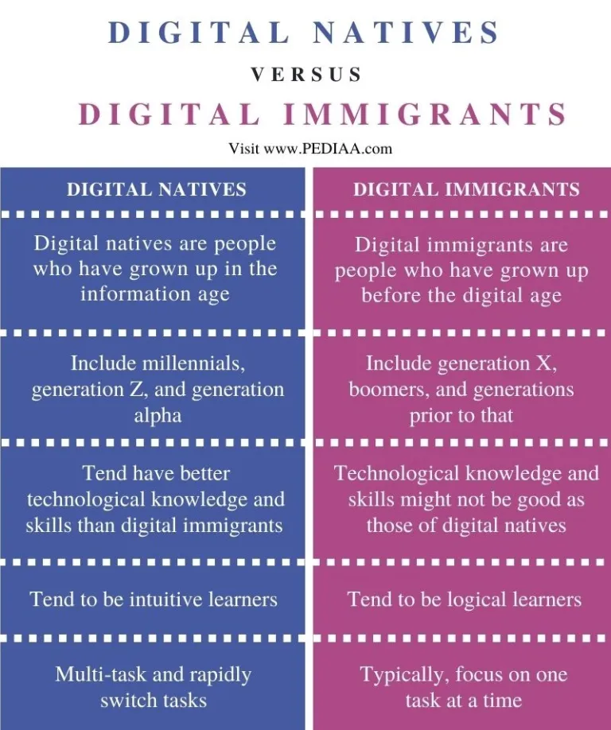
Dealing with the Mix of 21st Century Students and Teachers

Slide 25
Our Value Proposition
Comprehensive Learning Ecosystem
Personalized and Adaptive Learning
Collaborative and Engaging Experiences
Integrated hardware, software, and services that create a seamless and cohesive digital learning environment for students and teachers.
Ability to address the diverse needs of educational institutions, from primary to higher education, through our comprehensive suite of solutions.
Adaptive learning algorithms and personalized content delivery that cater to the unique learning styles and paces of individual students.
Integration of advanced technologies, such as artificial intelligence and machine learning, to continuously improve the personalization and efficacy of the learning experience.
Collaborative tools and features that foster teamwork, communication, and peer-to-peer learning among students.
Immersive and interactive learning content, including multimedia, simulations, and augmented/virtual reality, to enhance student engagement and motivation.
Actionable Data and Insights
Scalable and Flexible Solutions
Comprehensive Support and Professional Development
Robust data analytics and reporting capabilities that provide educators and administrators with real-time insights into student performance, learning patterns, and areas for improvement.
Predictive analytics and early intervention tools to help identify and address learning gaps or potential challenges before they escalate.
Scalable infrastructure and deployment options (on-premises, cloud-based, or hybrid) to accommodate the needs of educational institutions of varying sizes and resource levels.
Easily customizable and adaptable solutions that can be tailored to the specific requirements and learning objectives of different educational contexts.
Dedicated training, implementation, and ongoing technical support to ensure seamless integration and effective utilization of your EdTech solutions.
Continuous professional development programs and resources to empower teachers and administrators to maximize the potential of your digital tools and platforms.

Slide 26
Service Life Cycle
Feedback, Re-assessment, New technologies, Integration
Pre-Implementation
Implementation & Efficacy
Post-Implementation
Identify requirements
Specify environment configurations
Assess technology inventory
Provide training consultation
Assess integration requirements
Develop implementation plan
Installation of Hardware and Software
Product orientation to Onsite Technical Team
Training of End Users
Technical support
Help desk support
On-going training
Monitoring & maintenance
Usage data analysis
Reporting

Slide 27
Our Participation in Regional Technology Events
2011
Botswana First IT Exhibition (ITEX)
2011
Empire Synergy’s First SMART Conference for Education, Government and Business Sectors
2011
Botswana E-Government Consultative Forum
2013
Botswana Vendors Day Hosted by Debswana at Botswana Bureau of Standards
2013
Innovation Africa hosted in Botswana
2015
MESD IPS&P Conference at University of Botswana
2019
SMART Technologies Education and Business Conference in Gaborone
2023
Innovation Africa in Kigali, Rwanda
World Telecommunication and Information Society Day (WTISD) in Sefhare
2022

Slide 28
THANK YOU!
Mr. Peter Mooketsane
Executive Chairperson & Founder
+267-392-8427
peter@empiretechbw.com
Plot 22018, Unit 5, Kgomokasitwa

